Slide 1

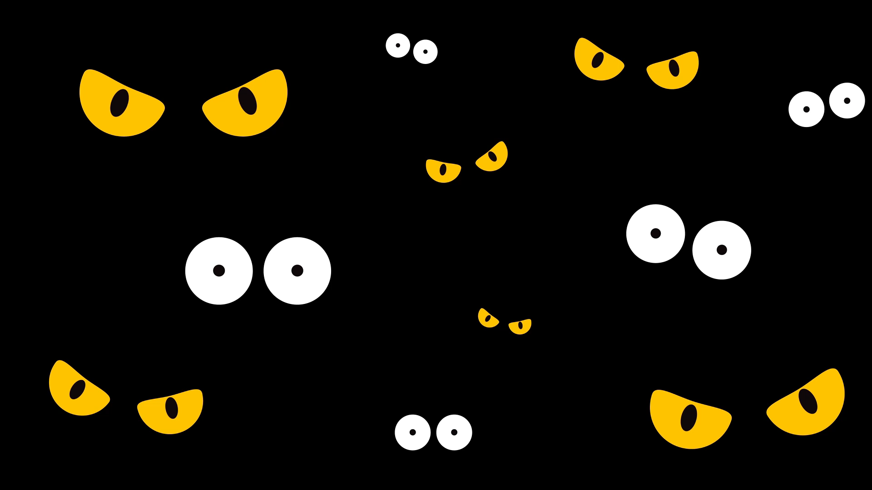
Chilean the killer

Slide 2
Table of contents
Who is Chilean ?
What does he kill?
The reason for his murders.
What does he use to kill his victims.
What to look out for?

Slide 3
Who is Chilean?
Chilean is a Chihuahua who has long been seen as a serious threat in the neighborhood. His family is not large. The lone child, he was. Chilean's parents and him had split up many years ago. He moves quite quickly. Nobody has been able to catch him or even catch a glimpse of him. He always completes the task at hand before vanishing.

Slide 4
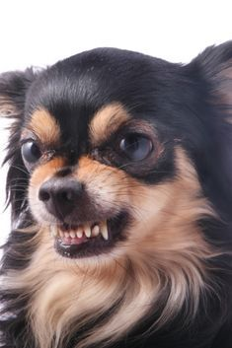

Slide 5
What does he kill?
Rottweilers are being massacred in Chile. Due to a weekly decline in numbers, the breed is extremely frightened. Most of the cops are on the hunt for him. They are unaware of his appearance. He had a hard time finding any data about him. They are unsure of his appearance.

Slide 6


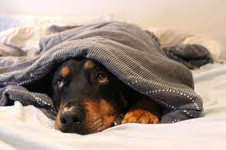

Slide 7
The reason for his murders.
It's unclear why there have been murders in Chile. He seemed to be seeking revenge against them. Theoretically, they contend that Chilean's family was parted because of the rottweiler. The investigators are still attempting to identify the real reason or reasons. They think there could be a variety of causes for the high death toll.

Slide 8
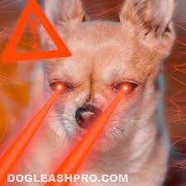
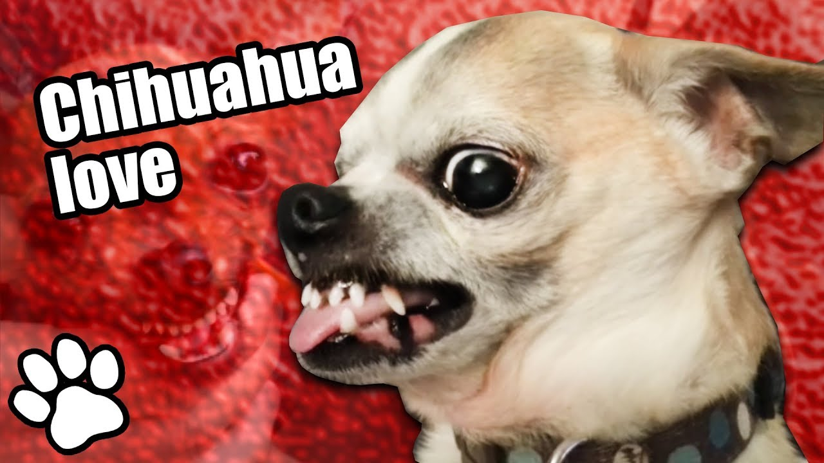
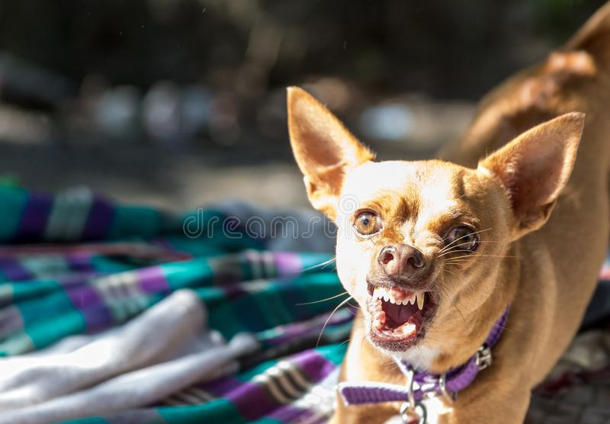


Slide 9
What does he use to kill his victims.
Police claim that Chilean uses a very pointed, sharp object, possibly a knife or sword.

Slide 10


Slide 11
What to look out for?
The cops are currently unaware of what a Chilean looks like. In completely protected houses, rottweilers do better. They shouldn't be walking about at night. They must keep in mind that a highly dangerous and swift chihuahua watches over them and desires to kill them.

Slide 12
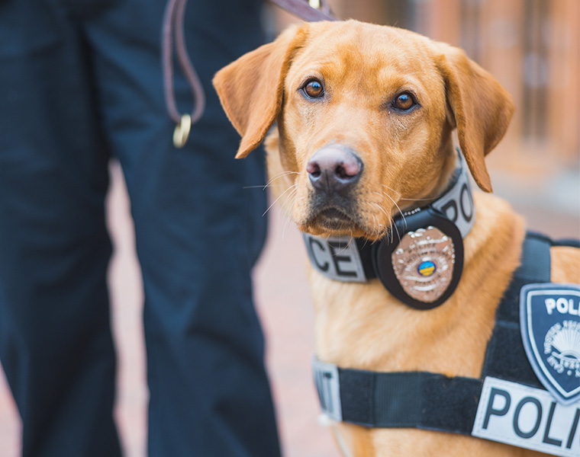
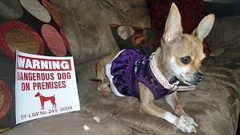

Slide 13
BE AWARE OF CHILEAN!
HE IS READY TO KILL!
THE END

